Slide 1
Lavash - AR Game
- Codarcea Alexandru-Christian

Slide 2


How it started
The genesis of Lavash began with a reimagining of the classic Angry Birds formula, brought to life through the immersive lens of Augmented Reality. While the satisfying physics of destruction served as the initial spark, the project’s true heartbeat lies in a fundamental shift in player agency. Unlike its predecessor, this game isn't limited to mere demolition. It introduces a core mechanic of construction, empowering players to build their own levels within their physical environment. This fusion transforms the experience from a simple arcade challenge into a creative sandbox where you are both the architect and the destroyer.
+ AR

Slide 3
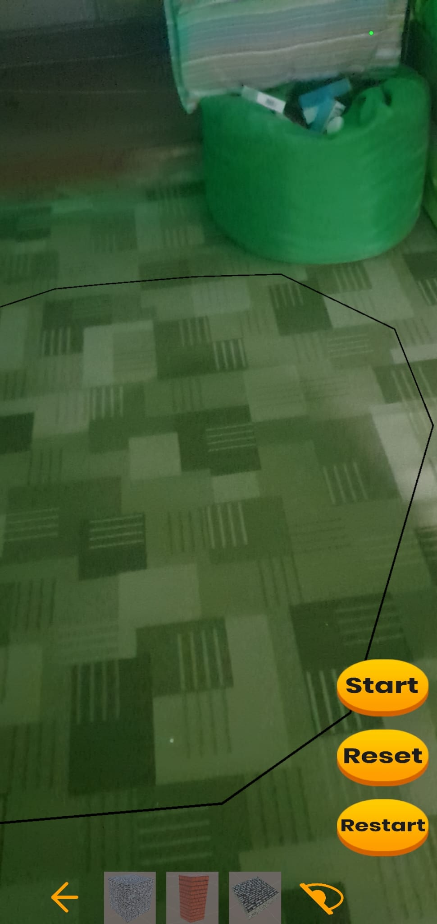
Game Guide
When you first open Lavash, you will be greeted by background music and responsive audio effects. Here is how to navigate the main building interface:
The Construction Zone: The game automatically detects flat surfaces in your room. The black outline highlights the detected plane. This area is your "canvas“ -> you can only place blocks and build structures within this boundary.
Building Bar: This is your inventory. It displays 3 meshes (building blocks) at a time. -To Build: Tap a mesh to select it, then tap on the plane to place it. -Navigation: Use the Left Arrow to cycle through all available options (9 building meshes and 3 scoring meshes). -Visibility: Tap the Right Icon to hide the menu if you need a clearer view of your creation.
Start Button: When you are done building, hit Start. This enables real-world physics (gravity will take effect) and begins the game timer. The time allowed to complete the level is exactly half (1/2) the time you spent building it.
Reset Button (Soft Refresh): Use this if your structure collapses immediately or doesn't sit right. It resets all objects to their original positions (before physics were enabled) so you can adjust them. This does NOT stop or reset the background timer.
Restart Button (Fresh Start): This is a complete wipe. It destroys all objects you have built and resets the timer to zero, allowing you to start a new level from scratch.
1
3
4
5
2

Slide 4
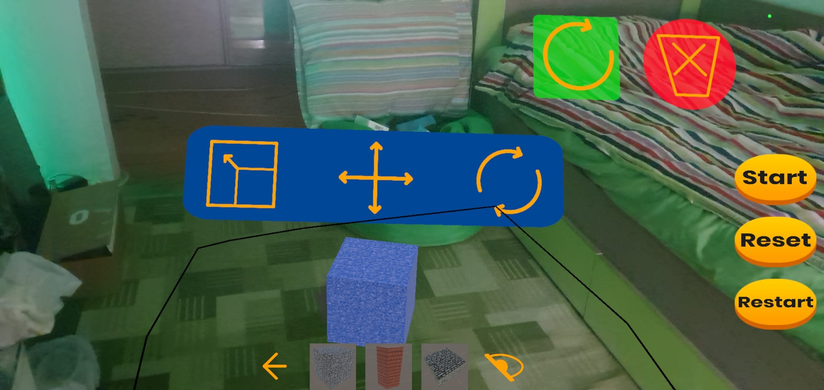
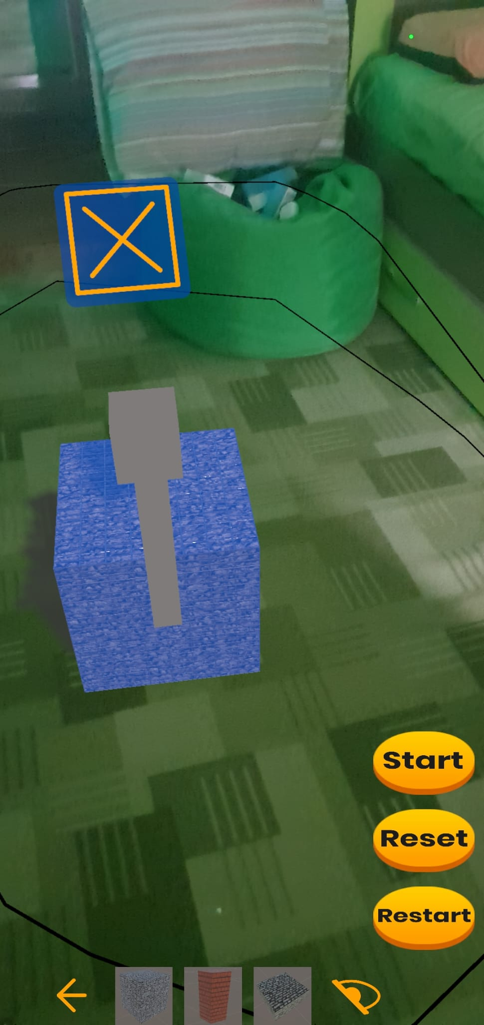
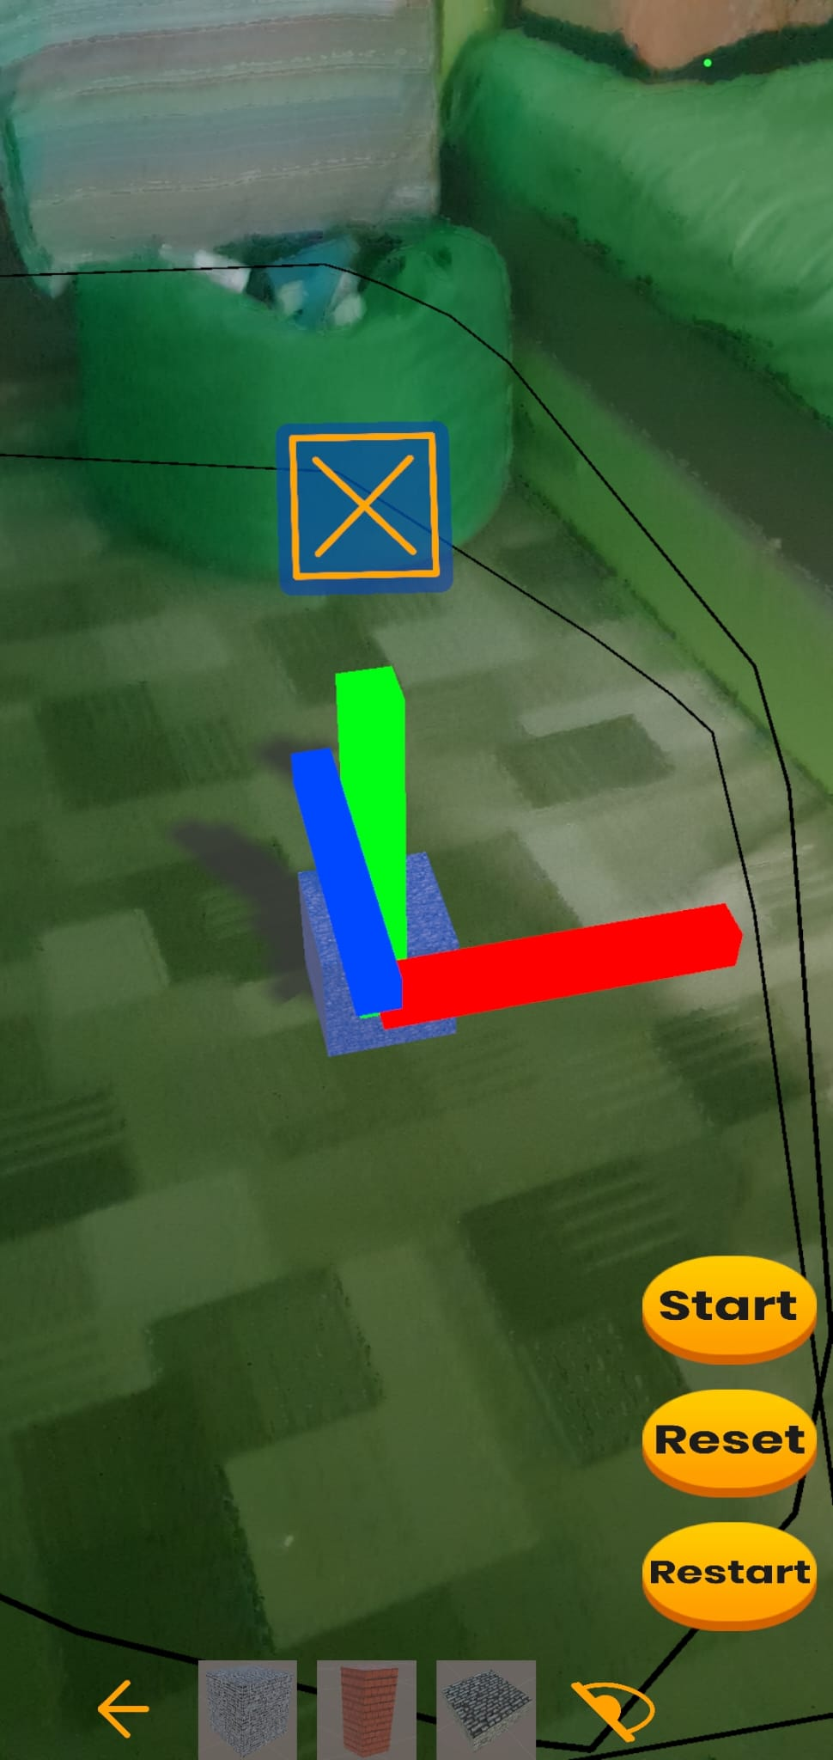
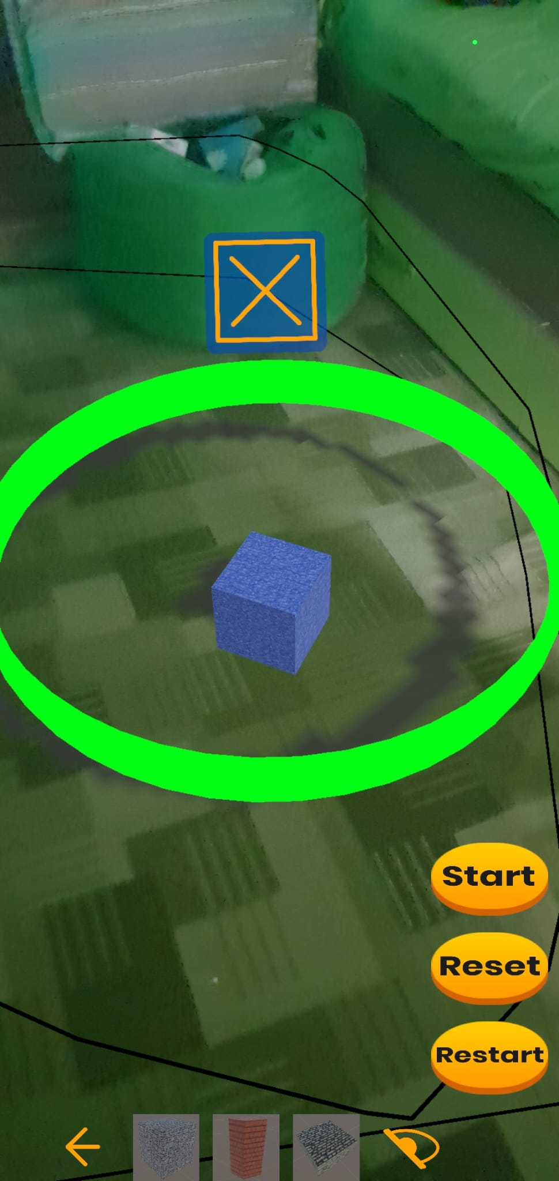
You might notice the interface layout shifts depending on how you hold your device. Lavash is designed to be fully adaptive, working seamlessly in both Portrait and Landscape modes. Simply rotate your phone to get the best angle for your creation, and the controls will automatically rearrange themselves to fit your screen.
Once you place an object, tap it to enter Edit Mode. You will know it is selected when a blue outline appears around it. A new menu will pop up at the top, giving you full control over the object:
Scale Tool: Tap this icon to resize your object. You can drag to make the block smaller or larger.
Move Tool: Select this to precisely adjust the object's position. This tool allows you to slide the object along the X, Y, and Z axes.
Rotate Tool: Tap here to spin the object. This rotates the mesh left or right around its vertical axis (Y-axis).
Reset Rotation: If you want to undo your spins, this button instantly snaps the object back to its original, straight orientation.
Delete: If you no longer need a block, press the Trash Icon (Red X) to remove it from the scene completely.
When using the Scale, Move, or Rotate tools, a small blue 'X' box will appear above the object. Tap it to confirm your adjustment and close that specific tool. To stop editing an object entirely, simply tap anywhere else on the screen or tap to select a different block.
1
2
3
4
5
1
2
3

Slide 5
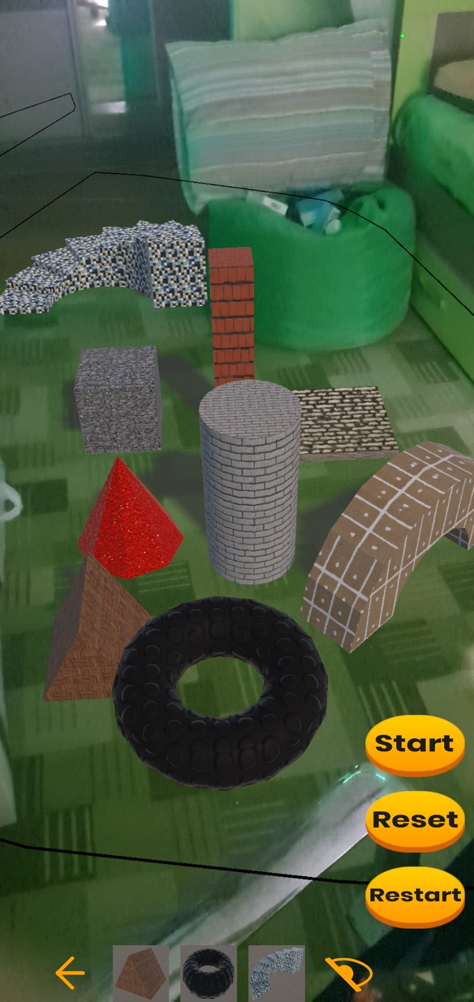
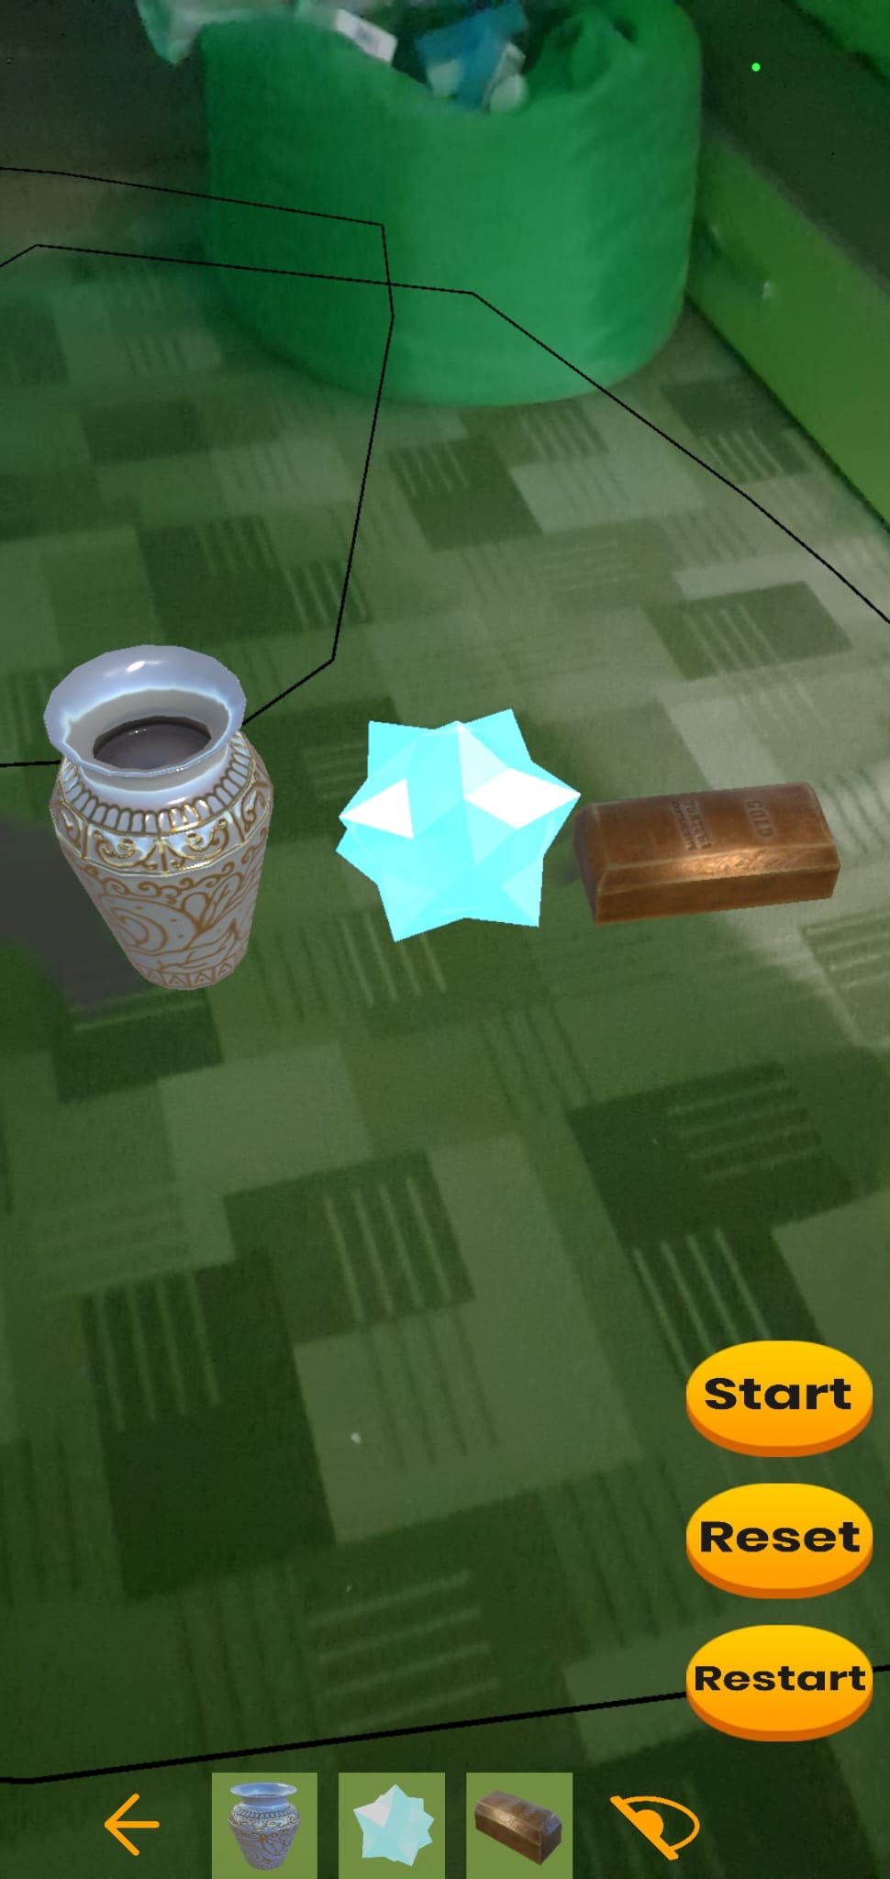
The Building Blocks: In this version, you have access to 9 unique building meshes. These shapes are your raw materials. By using the Scale, Move, and Rotate tools, you can get incredibly creative, even stacking blocks on top of one another. Whether you want to design a simple fortress or a towering castle, these blocks make it possible.
Shadows: As you look at the scene, notice that each object projects its own distinct shadow onto the floor. While this may seem like a small detail, it is impactful for the immersion, "grounding" the digital objects so they feel like they truly exist in your physical environment.
The Scoring Meshes: Alongside the standard blocks, there are 3 special Scoring Meshes. Unlike the structural blocks, these specific items are the key to earning points during gameplay. (We will cover the specific rules of the Scoring System later).
Quick Identification: To help you tell them apart at a glance, look at the Building Bar at the bottom of the screen. Standard Objects (Building Blocks) are shown with a grey background. Scoring Objects are highlighted with a green background, so you can easily spot your high-value items.
2
1
3
4

Slide 6
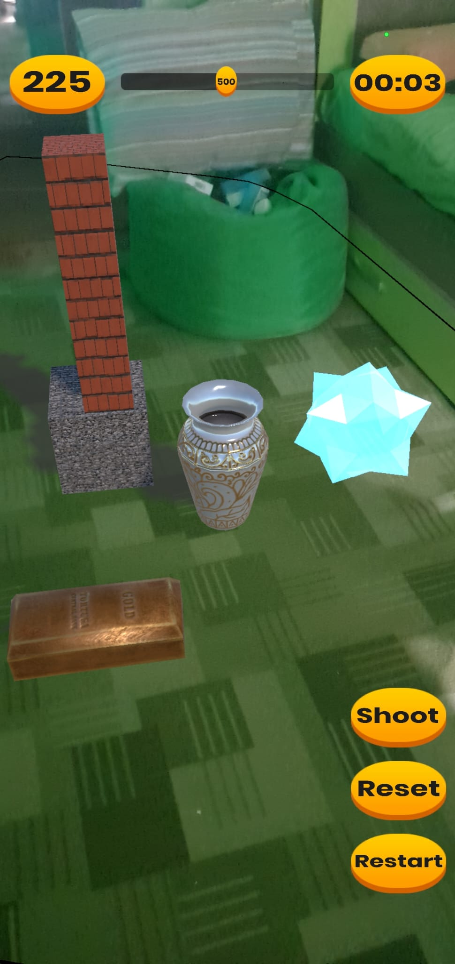
4
Once you press Start, you enter the Gameplay Phase.
The Launcher: Press the Shoot Button to launch a projectile. The ball spawns from the center of your screen and travels in the exact direction your camera is facing. To aim, simply move your phone to align the center of your view with your target.
The Timer: This countdown displays the time remaining to complete the level. -Secret Mechanic: You can tap the Timer Icon itself to buy +5 seconds. However, this comes at a strategic cost: you will be penalized -15 points from your score.
Power Control: This slider gives you control over the ball's velocity. The default force is set to 500, but you can adjust it anywhere from 1 to 1000.
The Scoring System: Your total score is displayed here. Points are earned by interacting with the Scoring Meshes you placed earlier. -Hit Points: Striking an object grants immediate points based on its value: Crystal (+35), Gold Ingot (+25), and Ceramic Jar (+15). -Ground Fall Bonus: If you knock a scoring object off a structure and it touches the floor, you receive a one-time 3x Multiplier reward based on that object's value. -Secret Mechanic: Tapping the Score Button instantly adds +5 points, but it sacrifices -1 second from your remaining time.
3
2
1

Slide 7
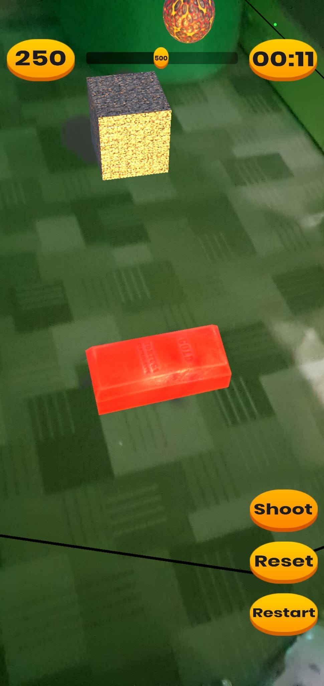
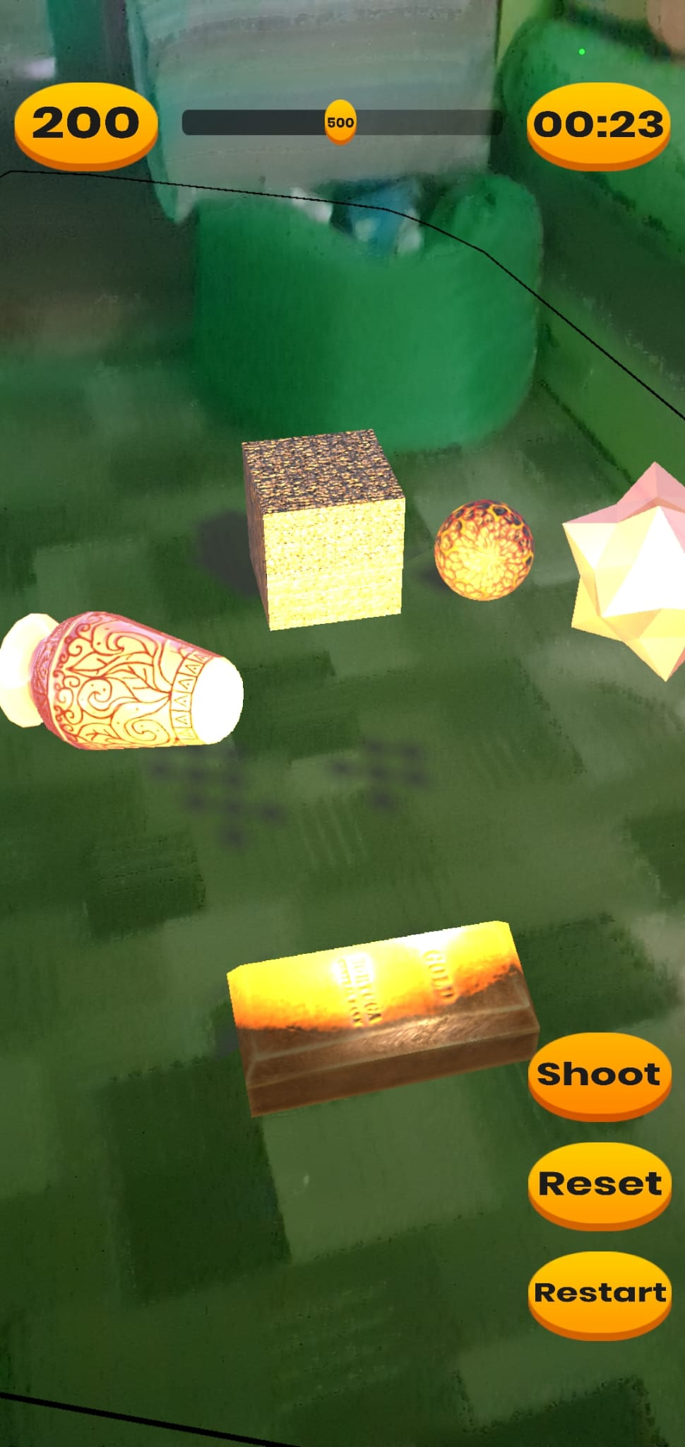
The Impact: This captures the moment right after a shot hits. You fire a Lava Ball, and upon contact, the game triggers a burst of effects: smoke, light, and a camera shake to simulate the force of the hit, accompanied by special audio cues. The Lava Ball lingers for 5 seconds before fading away. Notice that the Jar and Crystal have gained a distinct glow? That is the Red Aura, indicating they have taken damage.
The Despawn Window: You can see the Jar and Crystal are gone. Scoring objects automatically despawn 5 seconds after being hit. -Strategic Tip: This 5-second countdown is actually a "Bonus Window." You can hit a glowing object multiple times before it vanishes. Since every hit registers score, rapid-fire attacks on a dying object are a great way to maximize your points.
Visual Cues (The Red Aura): Here, the Gold Ingot is pulsing with that same Red Aura. This visual effect is a critical interface element: it tells you exactly which objects have been successfully hit and are about to disappear. When you see Red, you know the countdown has begun.
2
3
1

Slide 8
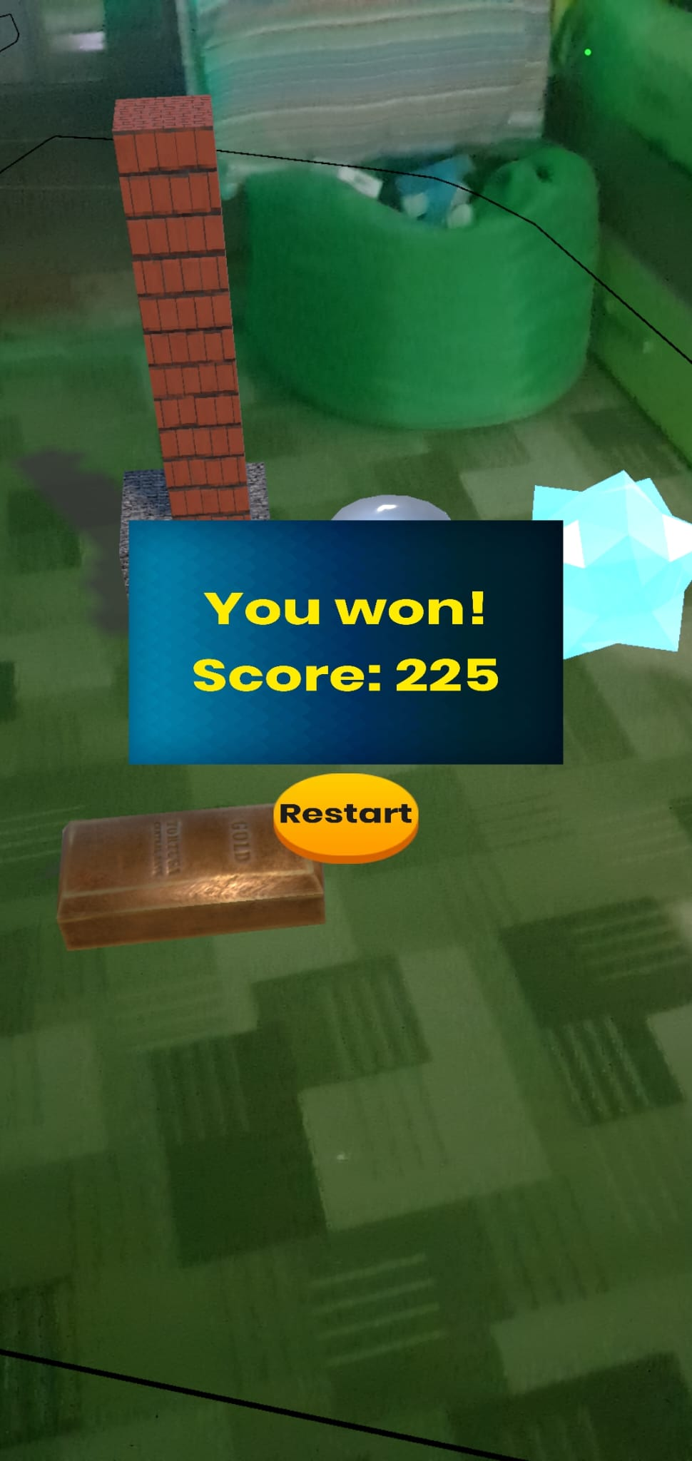
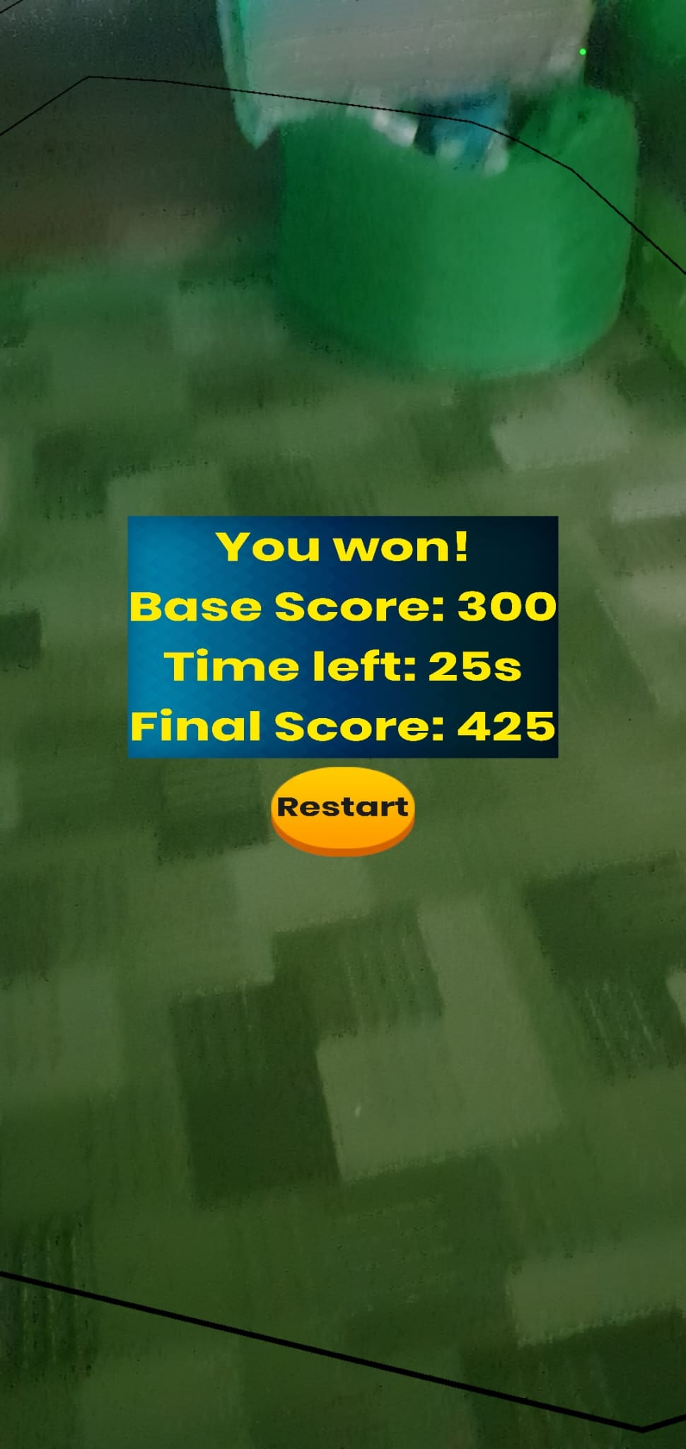
The Standard Victory: If the timer runs all the way down to 00:00, the game ends automatically. A summary screen will appear showing your Total Score accumulated from the Gameplay Phase.
Restart: The Restart Button is available here as well. Just like in the building phase, pressing this allows you to build a completely new level from scratch.
The Speed Bonus (Early Win): You don't have to wait for the clock to run out! If you manage to destroy (despawn) all scoring meshes before the timer hits zero, you trigger an Early Win. -The Reward: The game rewards efficiency. Your remaining time is converted into points with a 5x Multiplier. -The Breakdown: The end screen updates to show the full math: Base Score (points from hits) + (Time Left × 5) = Final Score. This is how you achieve the highest possible rankings!
1
3
2

Slide 9

How to Play: Solo & Local Multiplayer
As the developer, I designed Lavash with two primary playstyles in mind, giving you the flexibility to enjoy the game alone or turn it into a social competition.
Solo Mode: Dive into the game alone to enjoy the full creative loop. You are in complete control: build your own intricate worlds, then switch roles to destroy them. Your goal is to optimize your destruction strategy and beat your personal High Score. It is the perfect way to relax, experiment with the physics engine, and test your architectural limits.
Local Multiplayer: Want to challenge a friend? The game works perfectly as a local "couch co-op" experience: -The Loop: Hand your phone to a friend and let them build a level for you. Once they hit "Start," they pass the device back, and you have to destroy their creation. Then, reverse the roles! -Challenge Idea: Set a rule - for example, both players get 3 minutes to build a fortified structure using the same number of Scoring Meshes. Swap phones (or use just one phone), play the levels and compare your final scores to see who is the ultimate champion.

Slide 10

Game Showcase
To bring all the mechanics we just discussed together, I have prepared a comprehensive gameplay demonstration.
The Demo: This video captures a full 5-minute session, taking you through the entire game loop - from scanning the environment and building a fortress to the final physics-based destruction.
Real-Time Performance: The footage was recorded directly on a Samsung S10, demonstrating the game's stability and responsiveness on standard mobile hardware.
Watch Now: Please click the link on the left to experience the full gameplay showcase.
DEMO

Slide 11
Lavash - The End
Thank you!

